Slide 1
Biofilm
A NEW WORD OF AGRICULTURAL BUSINESS

Slide 2
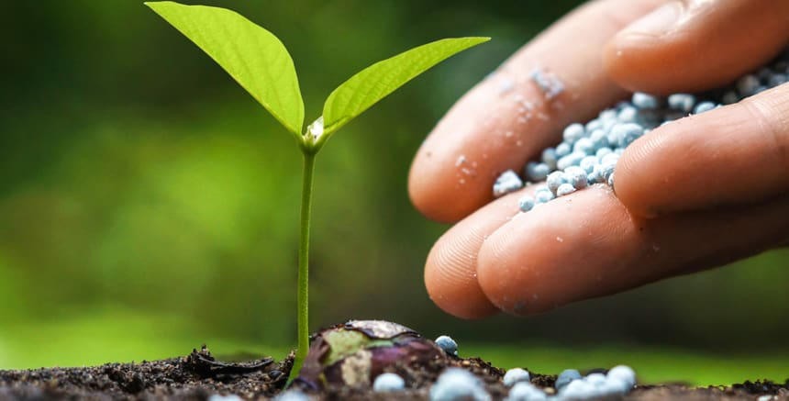
Problem
Replacement of ARCHAIC
chemical fertilizers
2. ENHANCEMENT of microbial fertilizers activity
3. Plant growth IMPROVEMENT
4. ECOLOGY support

Slide 3
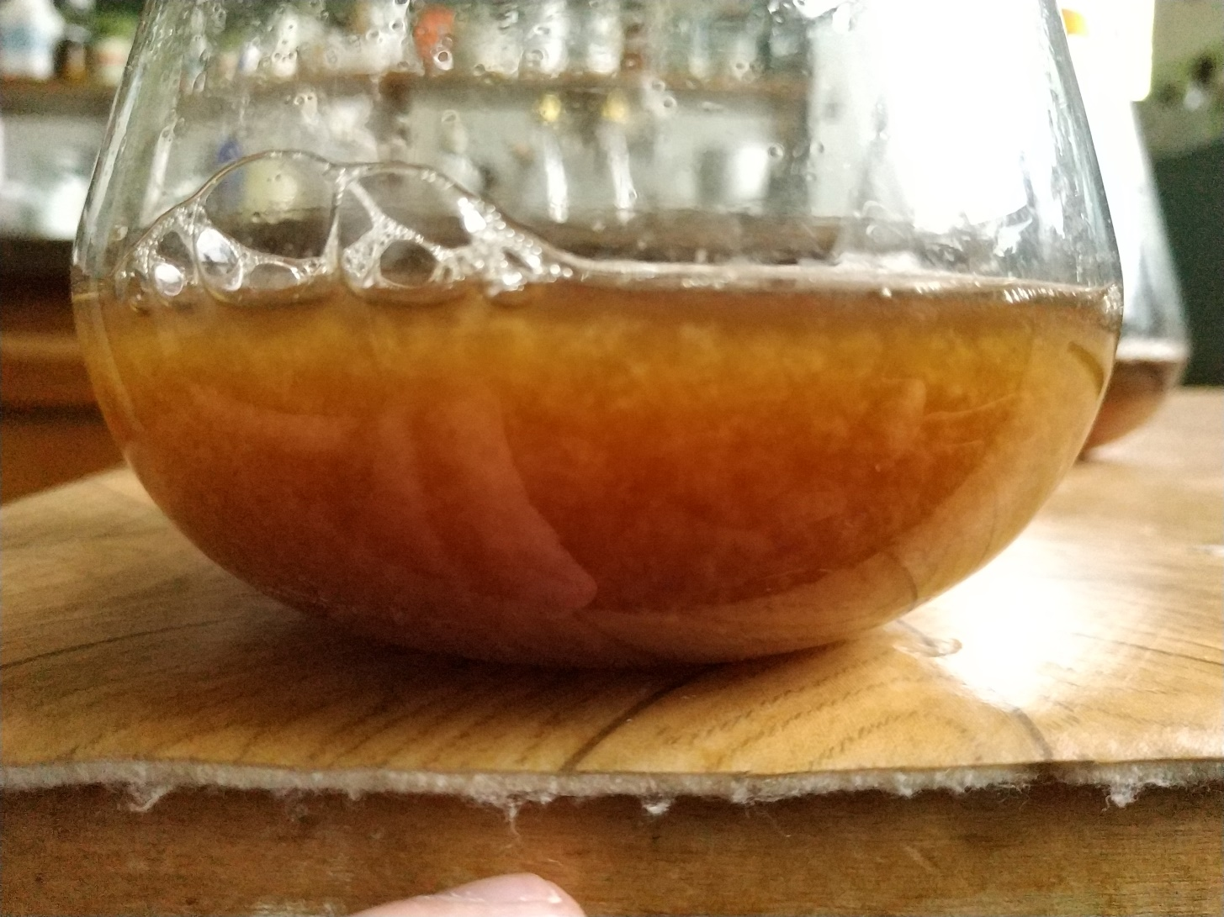
Solution
“Biofilm” biofertilizer utilization

Slide 4
Novelty
“Biofilm” – development of high-active biofertilizer of new generation
Novel approach:
Utilization of ECO-FRIENDLY living carriers

Slide 5
Market
World market of biopreparations:
3 billion US dollars

Slide 6
Competitors
Properties | Biofilm | Azotofit | Azogran А
Eco-friendliness
Prolonged activity of microorganisms
Increased activity
Price, UAN/l | 30 | 195 | 171

Slide 7
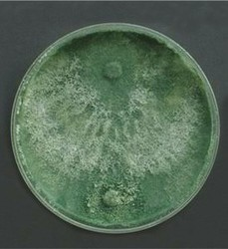
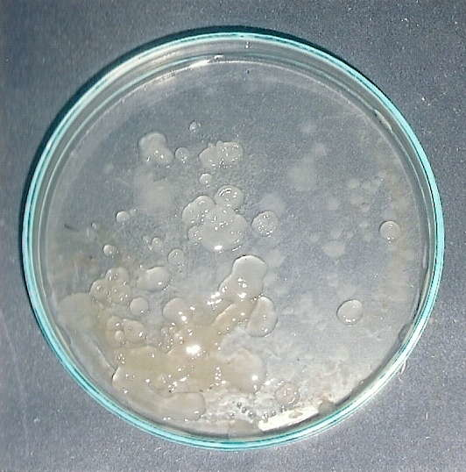
How does it work?
Fungi
Bacteria
Plant growth promotion

Slide 8
Business model
2433 agricultural enterprises with an area of 100 - 500 hectares
1837 agricultural enterprises with an area of 1000-2000 hectares
B2B
5800 UAH from one enterprise after one-time land-treatment
31000 UAH from one enterprise after one-time land-treatment
MAXIMUM POTENTIAL INCOME :
70 million UAN

Slide 9
Marketing
Targeted advertising on social media
Agricultural exhibitions
Scientific conferences

Slide 10
Roadmap
September
2018
March
2019
June
2019
September
2019
IDEA
PROTOTYPE
BIOFERTILIZER ACTIVITY
EVALUATION
SMALL-SCALE
PRODUCTION

Slide 11
Team
Maksym

